Slide 1
Lecture 17 Hashing
CSE225: Data Structures and Algorithms

Slide 2
Searching
Consider the problem of searching an array for a given value
If the array is not sorted, the search requires O(n) time
If the value isn’t there, we need to search all n elements
If the value is there, we search n/2 elements on average
If the array is sorted, we can do a binary search
A binary search requires O(log n) time
About equally fast whether the element is found or not
It doesn’t seem like we could do much better
How about an O(1), that is, constant time search?
We can do it if the array is organized in a particular way

Slide 3
Hashing
Suppose we were to come up with a “magic function” that, given a value to search for, would tell us exactly where in the array to look
If it’s in that location, it’s in the array
If it’s not in that location, it’s not in the array
This function would have no other purpose
This function is called a hash function because it “makes hash” of its inputs

Slide 4
Hashing
Each item has a key
A hash function is a function that:
When applied to an key, returns a number
When applied to equal keys, returns the same number for each
When applied to unequal keys, is very unlikely to return the same number for each
Hash functions turn out to be very important for searching, that is, looking things up fast
This is their story....

Slide 5
Hashing
Hash table using direct addressing:
Use the key itself for indexing
The record with key i is stored at the i^{th} index of the array
index | ID (key) | Secret Agent
0 | 0 | Inferno
1 | 1 | Reaper
2 | 2 | Vanguard
3 | 3 | Wolfhound
4 | 4 | Firefly
5 | 5 | Panzer Division
6 | 6 | Iron Horse
What if we used the agent’s cell phone number as key? We would need an array of 10¹¹ elements just to store 7 records.

Slide 6
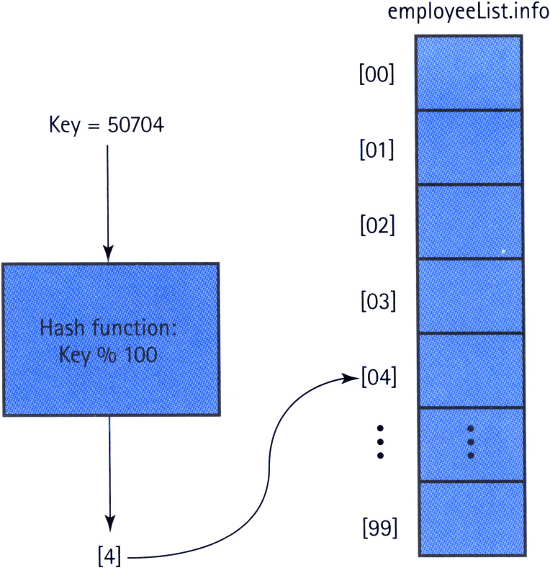
Hashing
Solution: Modify the hash function as (Key % 100)
Array size

Slide 7
Collision
0
U
(universe of keys)
h(k₁)
h(k₄)
k₁
K
(actual
keys)
k₄
k₂
h(k₂) = h(k₅)
k₅
k₃
h(k₃)
m - 1
h : U → {0, 1, . . . , m - 1}
hash table size: m

Slide 8
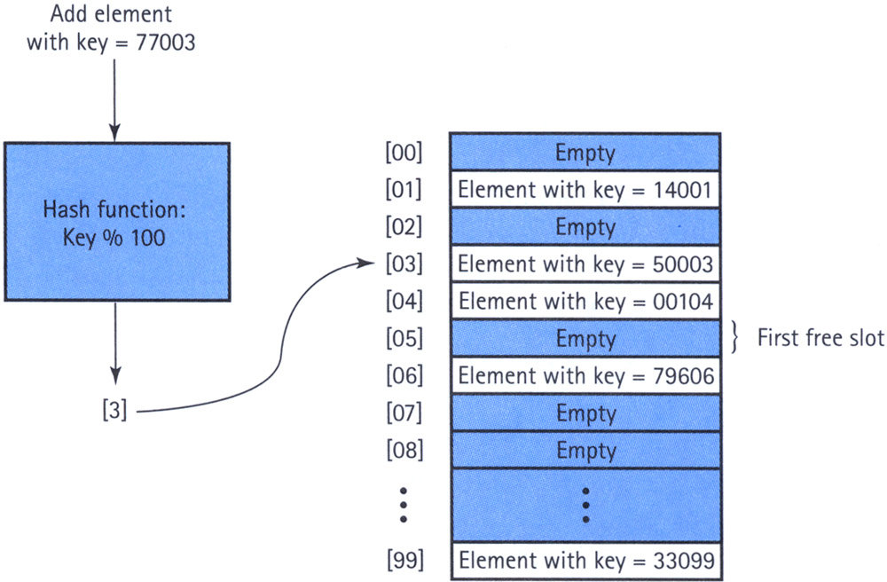
Linear Probing
Insert 77003
Collision occurs
Insert 77003 at the next available spot (treat the array in a circular way)

Slide 9
Issues with Linear Probing
Leads to problem of clustering. Elements tend to cluster in dense intervals in the array.
Search efficiency problem remains.
Deletion becomes trickier….
••••••• •••••• ••••••••••• ••••••• •

Slide 10
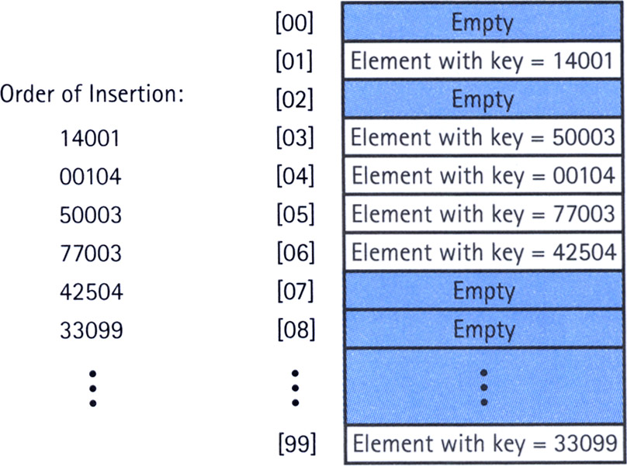
Issues with Linear Probing
Records may also be deleted from a hash table.
But the location must not be left as an ordinary "empty spot" since that could interfere with searches.
The location must be marked in some special way so that a search can tell that the spot used to have something in it.
Notes:
Instead we must somehow mark the location as "a location that used to have something here, but no longer does."
We might do this by using some other special value for the Number field of the record.
In any case, a search can not stop when it reaches "a location that used to have something here". A search can only stop when it reaches a true empty spot.

Slide 11
Rehashing
Resolving a collision by computing a new hash location from a hash function that manipulates the original location rather than the element's key
(HashValue + constant) % array-size
Quadratic probing Resolving a hash collision by using the rehashing formula (HashValue ± I²) % array-size, where I is the number of times that the rehash function has been applied
Random probing Resolving a hash collision by generating pseudo-random hash values in successive applications of the rehash function
Caution: Constant and array size must be relatively prime.
Notes:
Instead we must somehow mark the location as "a location that used to have something here, but no longer does."
We might do this by using some other special value for the Number field of the record.
In any case, a search can not stop when it reaches "a location that used to have something here". A search can only stop when it reaches a true empty spot.

Slide 12
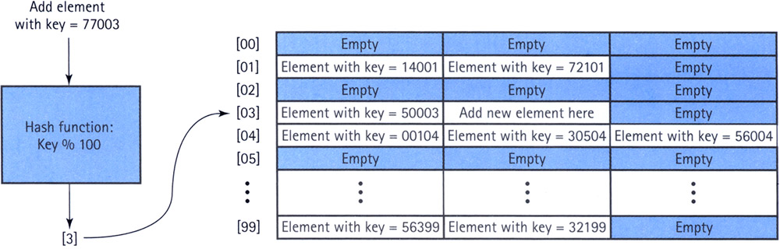
Buckets and Chaining
Bucket: A collection of elements associated with a particular hash location
Notes:
Instead we must somehow mark the location as "a location that used to have something here, but no longer does."
We might do this by using some other special value for the Number field of the record.
In any case, a search can not stop when it reaches "a location that used to have something here". A search can only stop when it reaches a true empty spot.

Slide 13
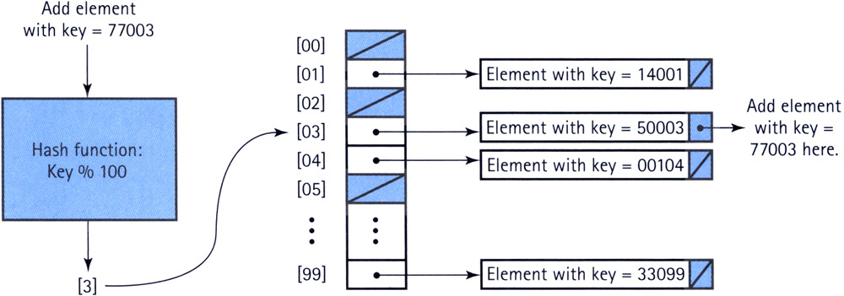
Buckets and Chaining
Chain: A linked list of elements that share the same hash location
Notes:
Instead we must somehow mark the location as "a location that used to have something here, but no longer does."
We might do this by using some other special value for the Number field of the record.
In any case, a search can not stop when it reaches "a location that used to have something here". A search can only stop when it reaches a true empty spot.

Slide 14
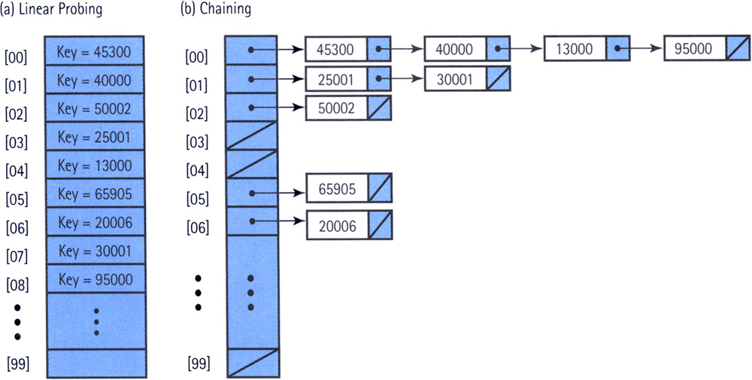
Comparison Between Linear Probing and Chaining
Insertion order: 45300, 20006, 50002, 40000, 25001, 13000, 65905, 30001, 95000 (search for 30001)
Notes:
Instead we must somehow mark the location as "a location that used to have something here, but no longer does."
We might do this by using some other special value for the Number field of the record.
In any case, a search can not stop when it reaches "a location that used to have something here". A search can only stop when it reaches a true empty spot.

Slide 15
Folding
A hash method that breaks the key into several pieces and concatenates or exclusive-ORs some of the pieces to form the hash value
Example:
Key is a 32 bit integer
Array size is 256
So we need 8 bits
Break the key into four bit strings of 8 bits each,
Exclusive-OR the first and last bit strings,
Exclusive-OR the two middle bit strings, and
Exclusive-OR the results of steps 2 and 3 to produce the 8-bit index into the array.
Notes:
Instead we must somehow mark the location as "a location that used to have something here, but no longer does."
We might do this by using some other special value for the Number field of the record.
In any case, a search can not stop when it reaches "a location that used to have something here". A search can only stop when it reaches a true empty spot.

Slide 16
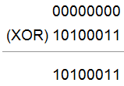
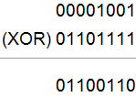
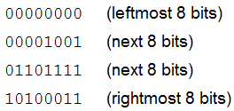
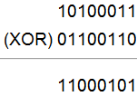
Folding
We illustrate this scheme using the key 618403. The binary representation of this key is
00000000000010010110111110100011
This binary number is equivalent to the decimal number 197, so the key 618403 hashes into the index 197.
Notes:
Instead we must somehow mark the location as "a location that used to have something here, but no longer does."
We might do this by using some other special value for the Number field of the record.
In any case, a search can not stop when it reaches "a location that used to have something here". A search can only stop when it reaches a true empty spot.

